Slide 1
Are physics-math-based iteration methods
and physics-informed neural network methods
in static magnetic field calculation
more different or more similar?
Mingyu Jeon², G. S. Choe^{1,2}, Sibaek Yi², Minseon Lee¹
¹School of Space Research, Kyung Hee University
²Department of Astronomy and Space Science, Kyung Hee University

Slide 2
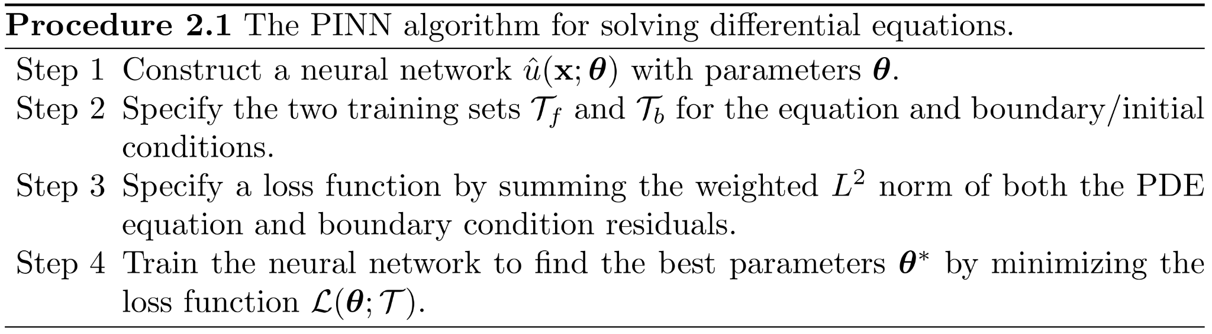
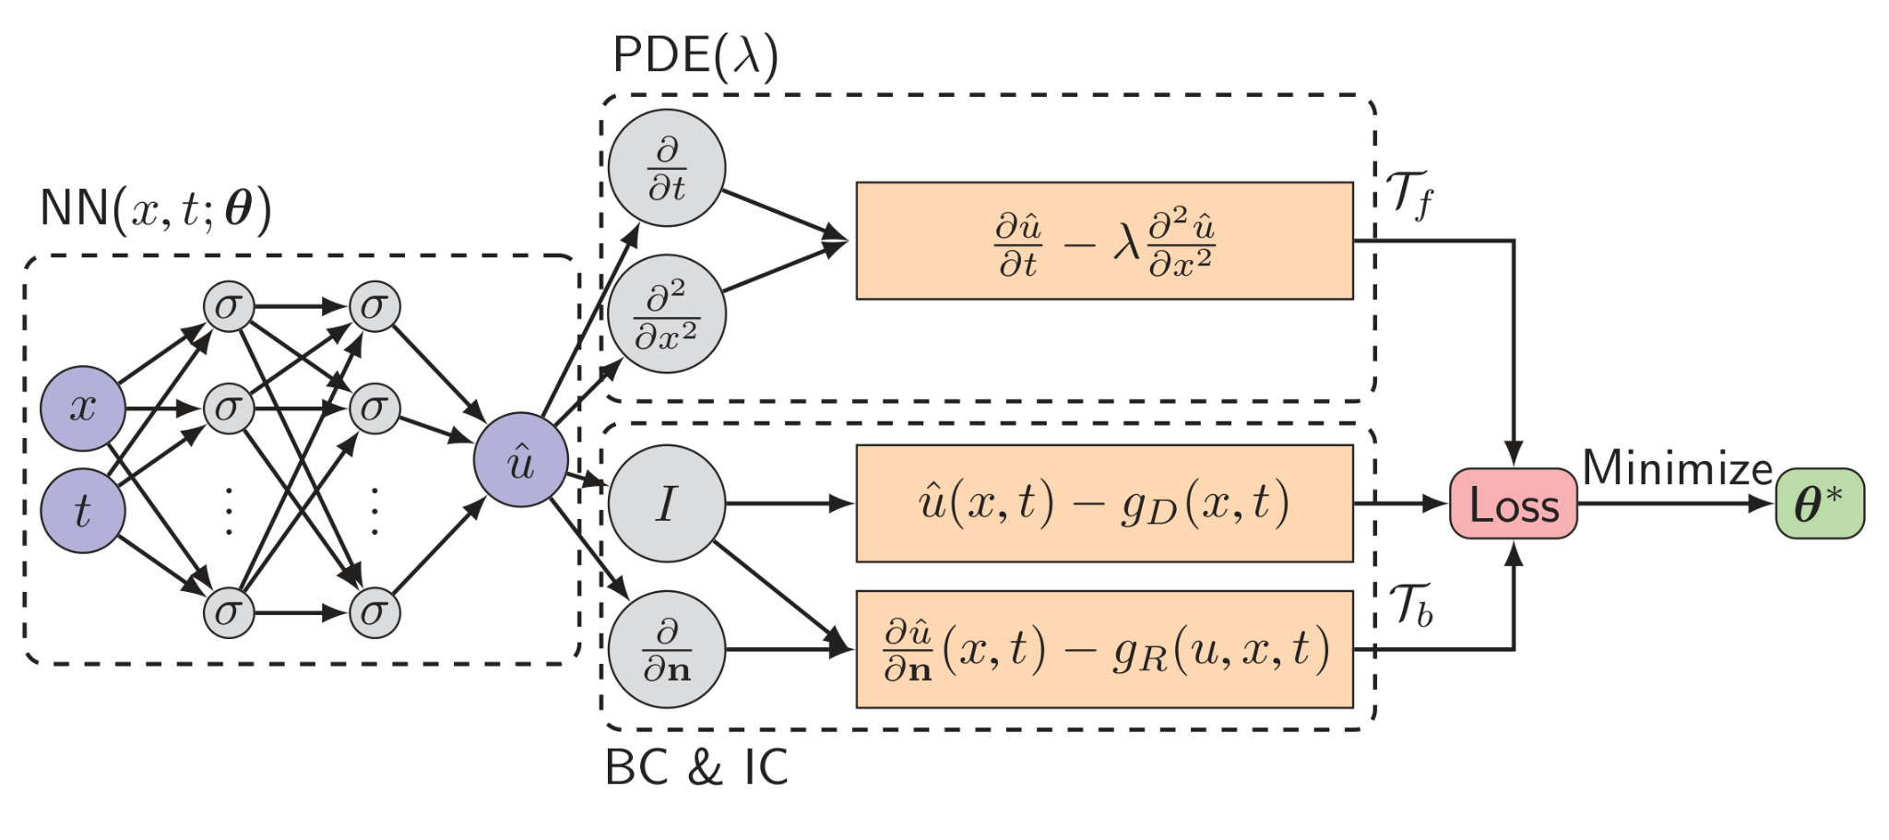
Physics-informed neural networks (PINNs)
Lu et al. 2021

Slide 3
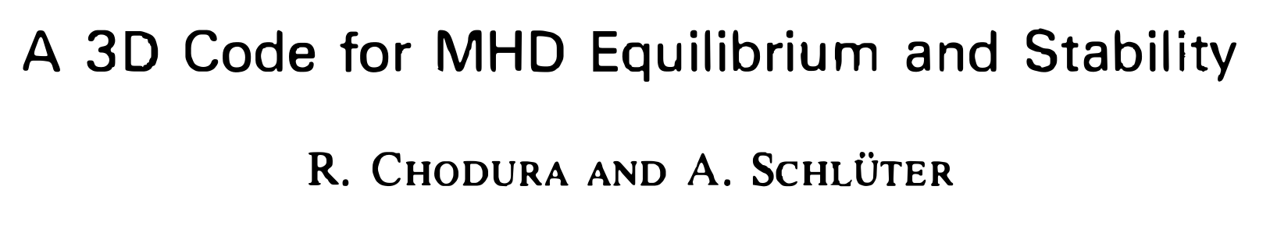

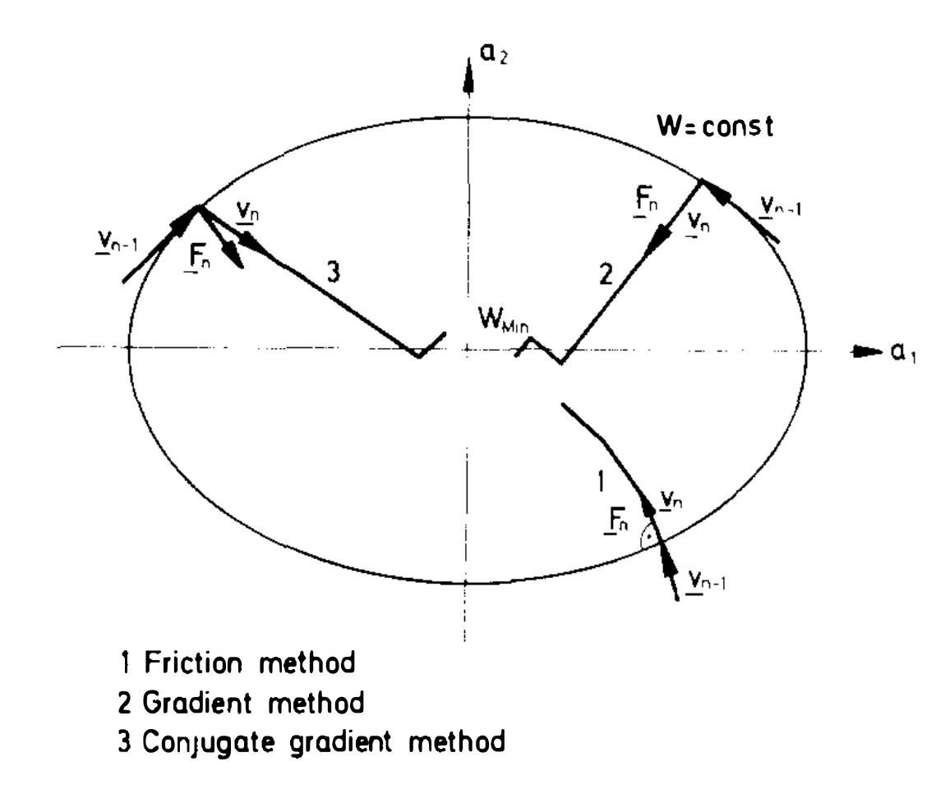
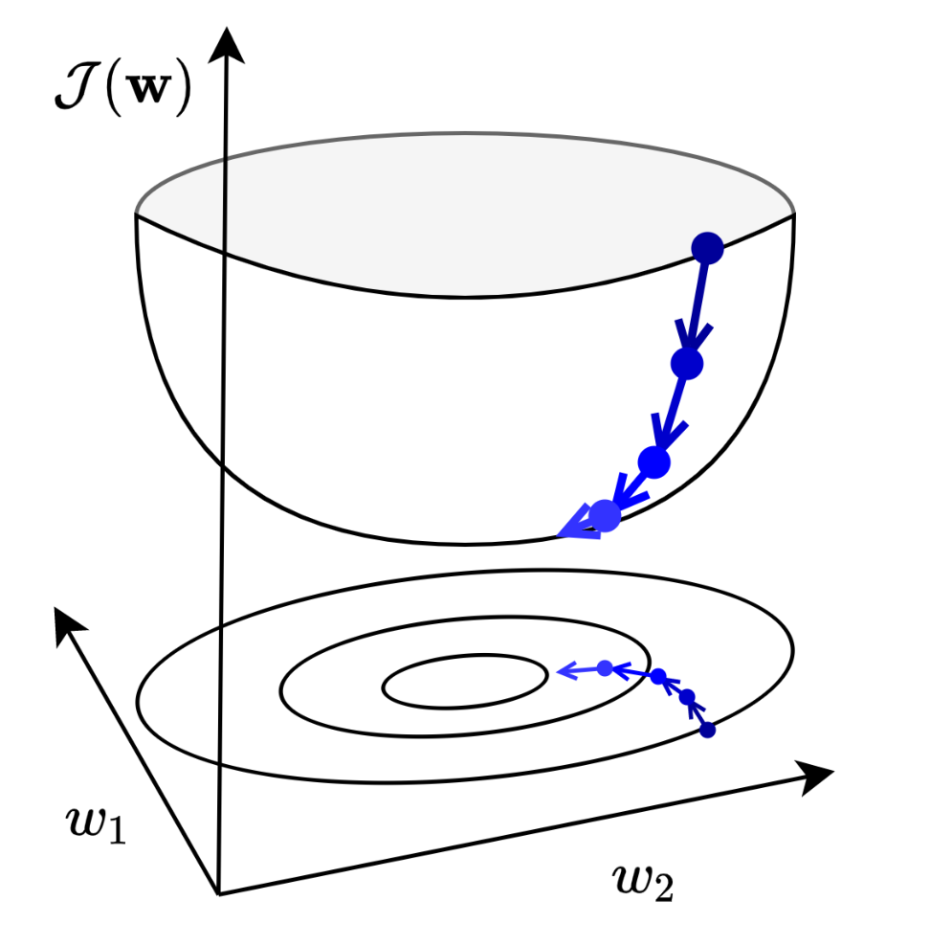
Gradient descent
Grosse et al. 2021
Chodura et al. 1981

Slide 4
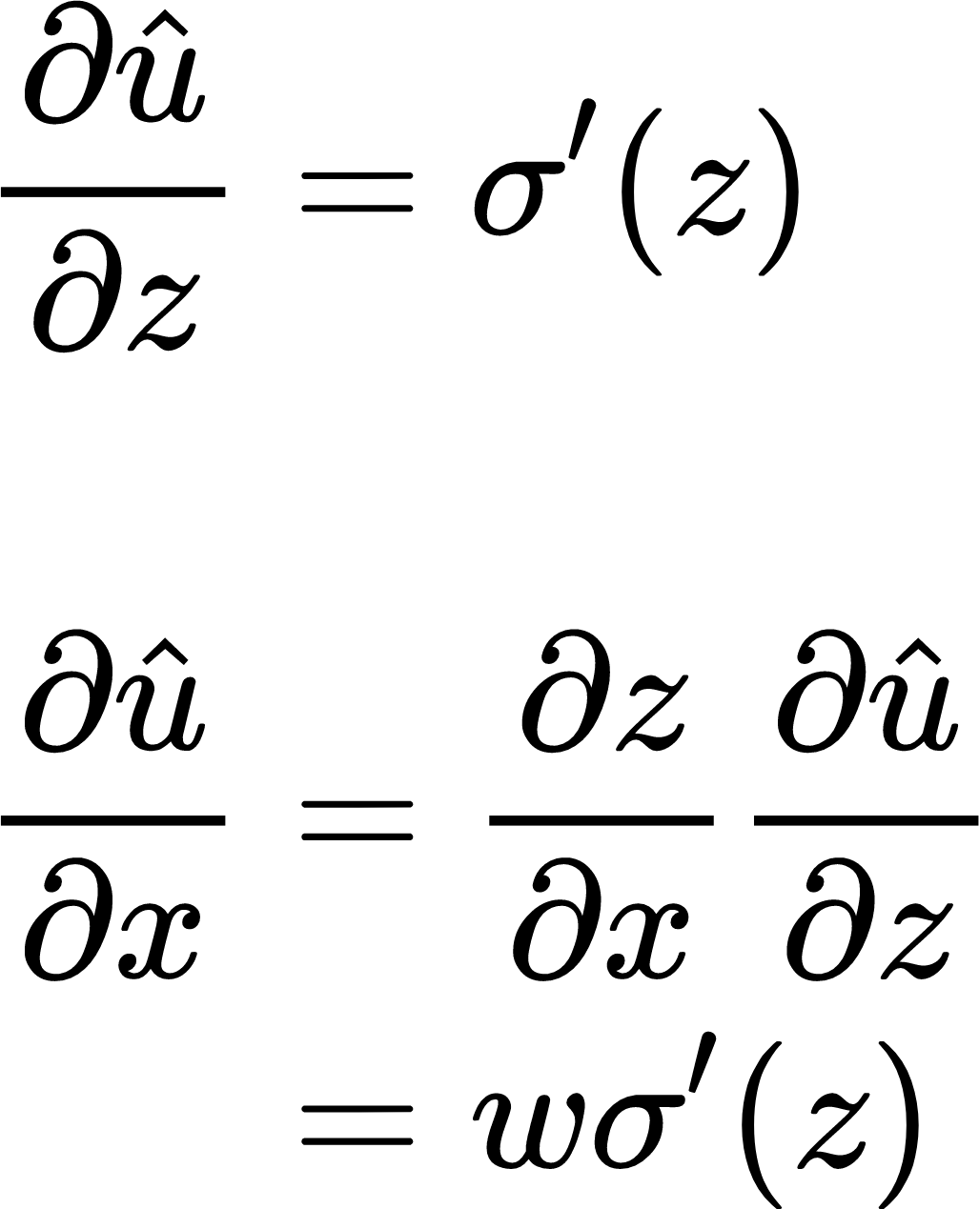
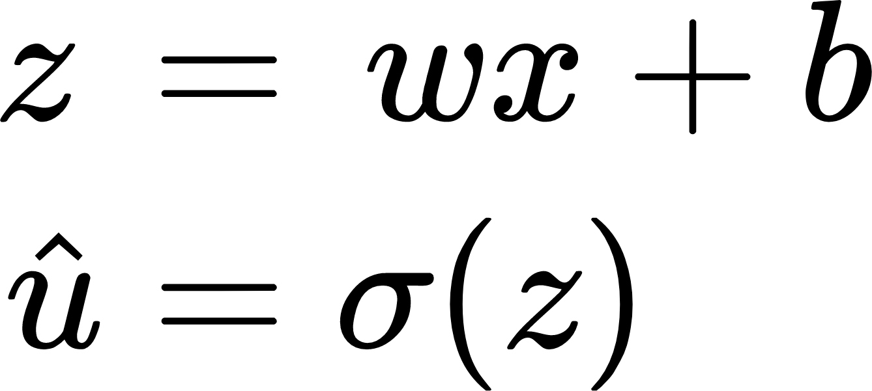
Automatic differentiation

Slide 5
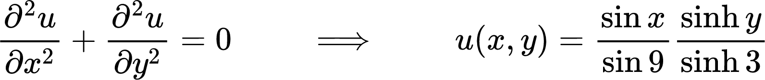
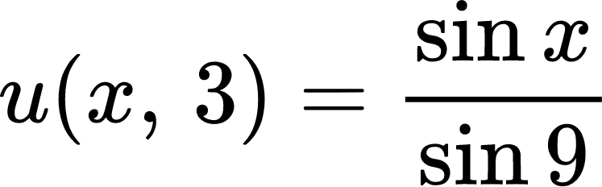
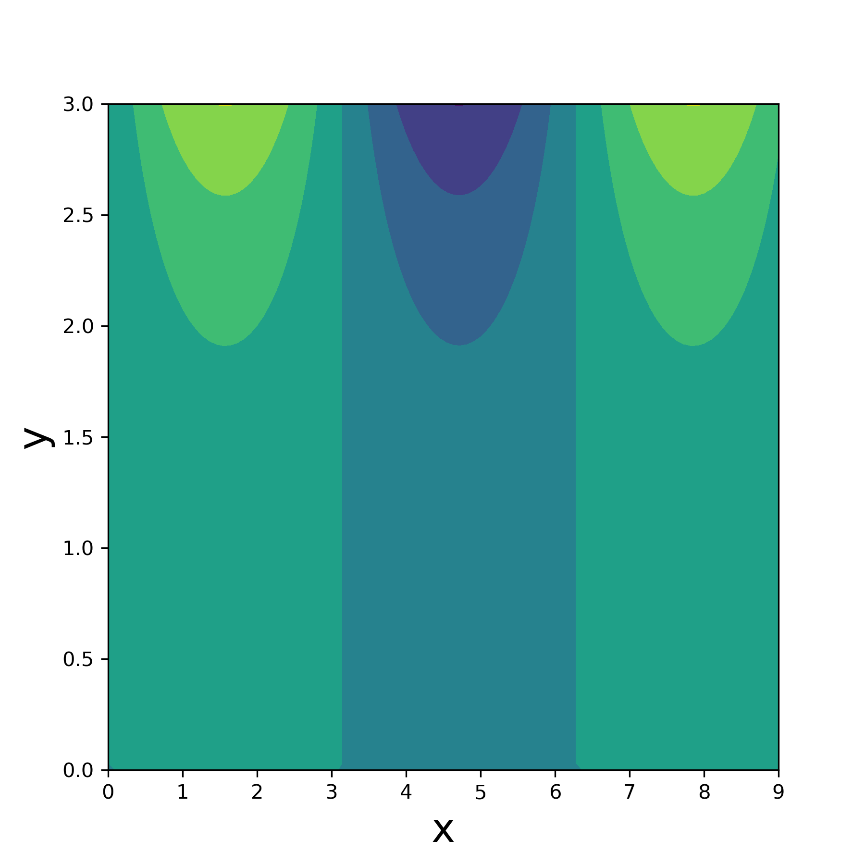
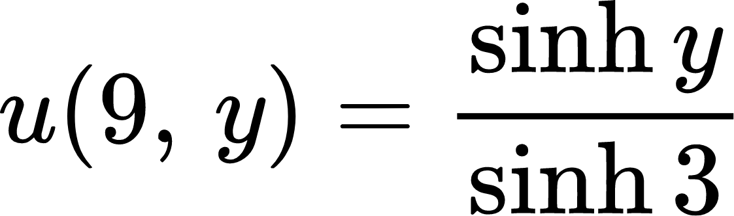
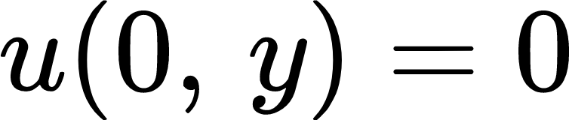
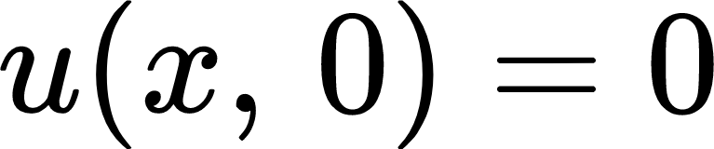
PINN example: 2D Laplace equation

Slide 6
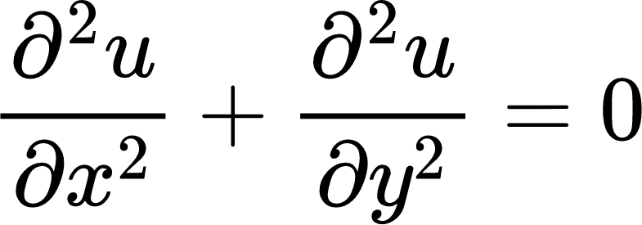
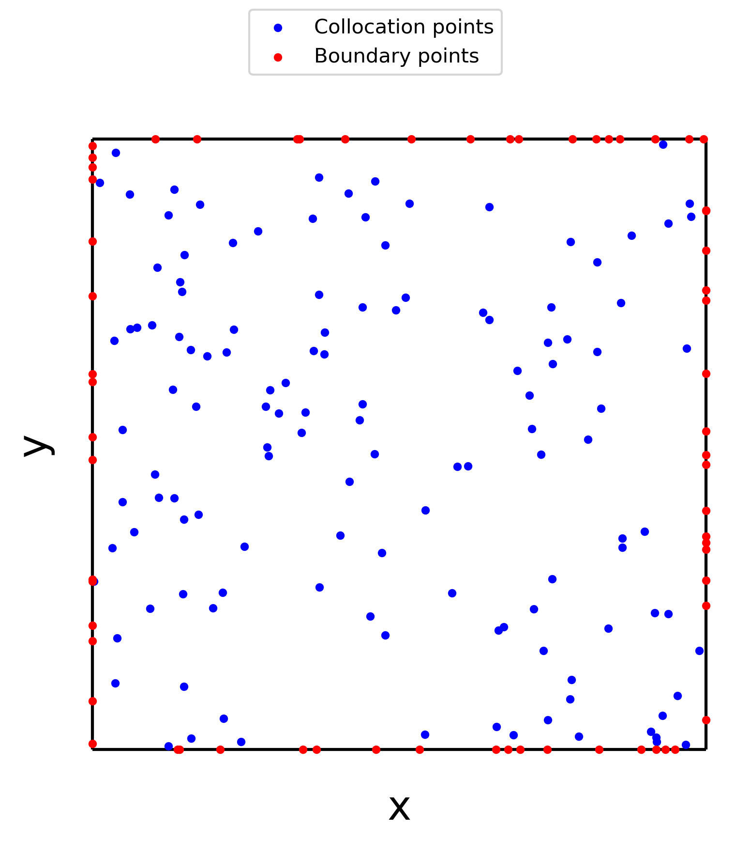
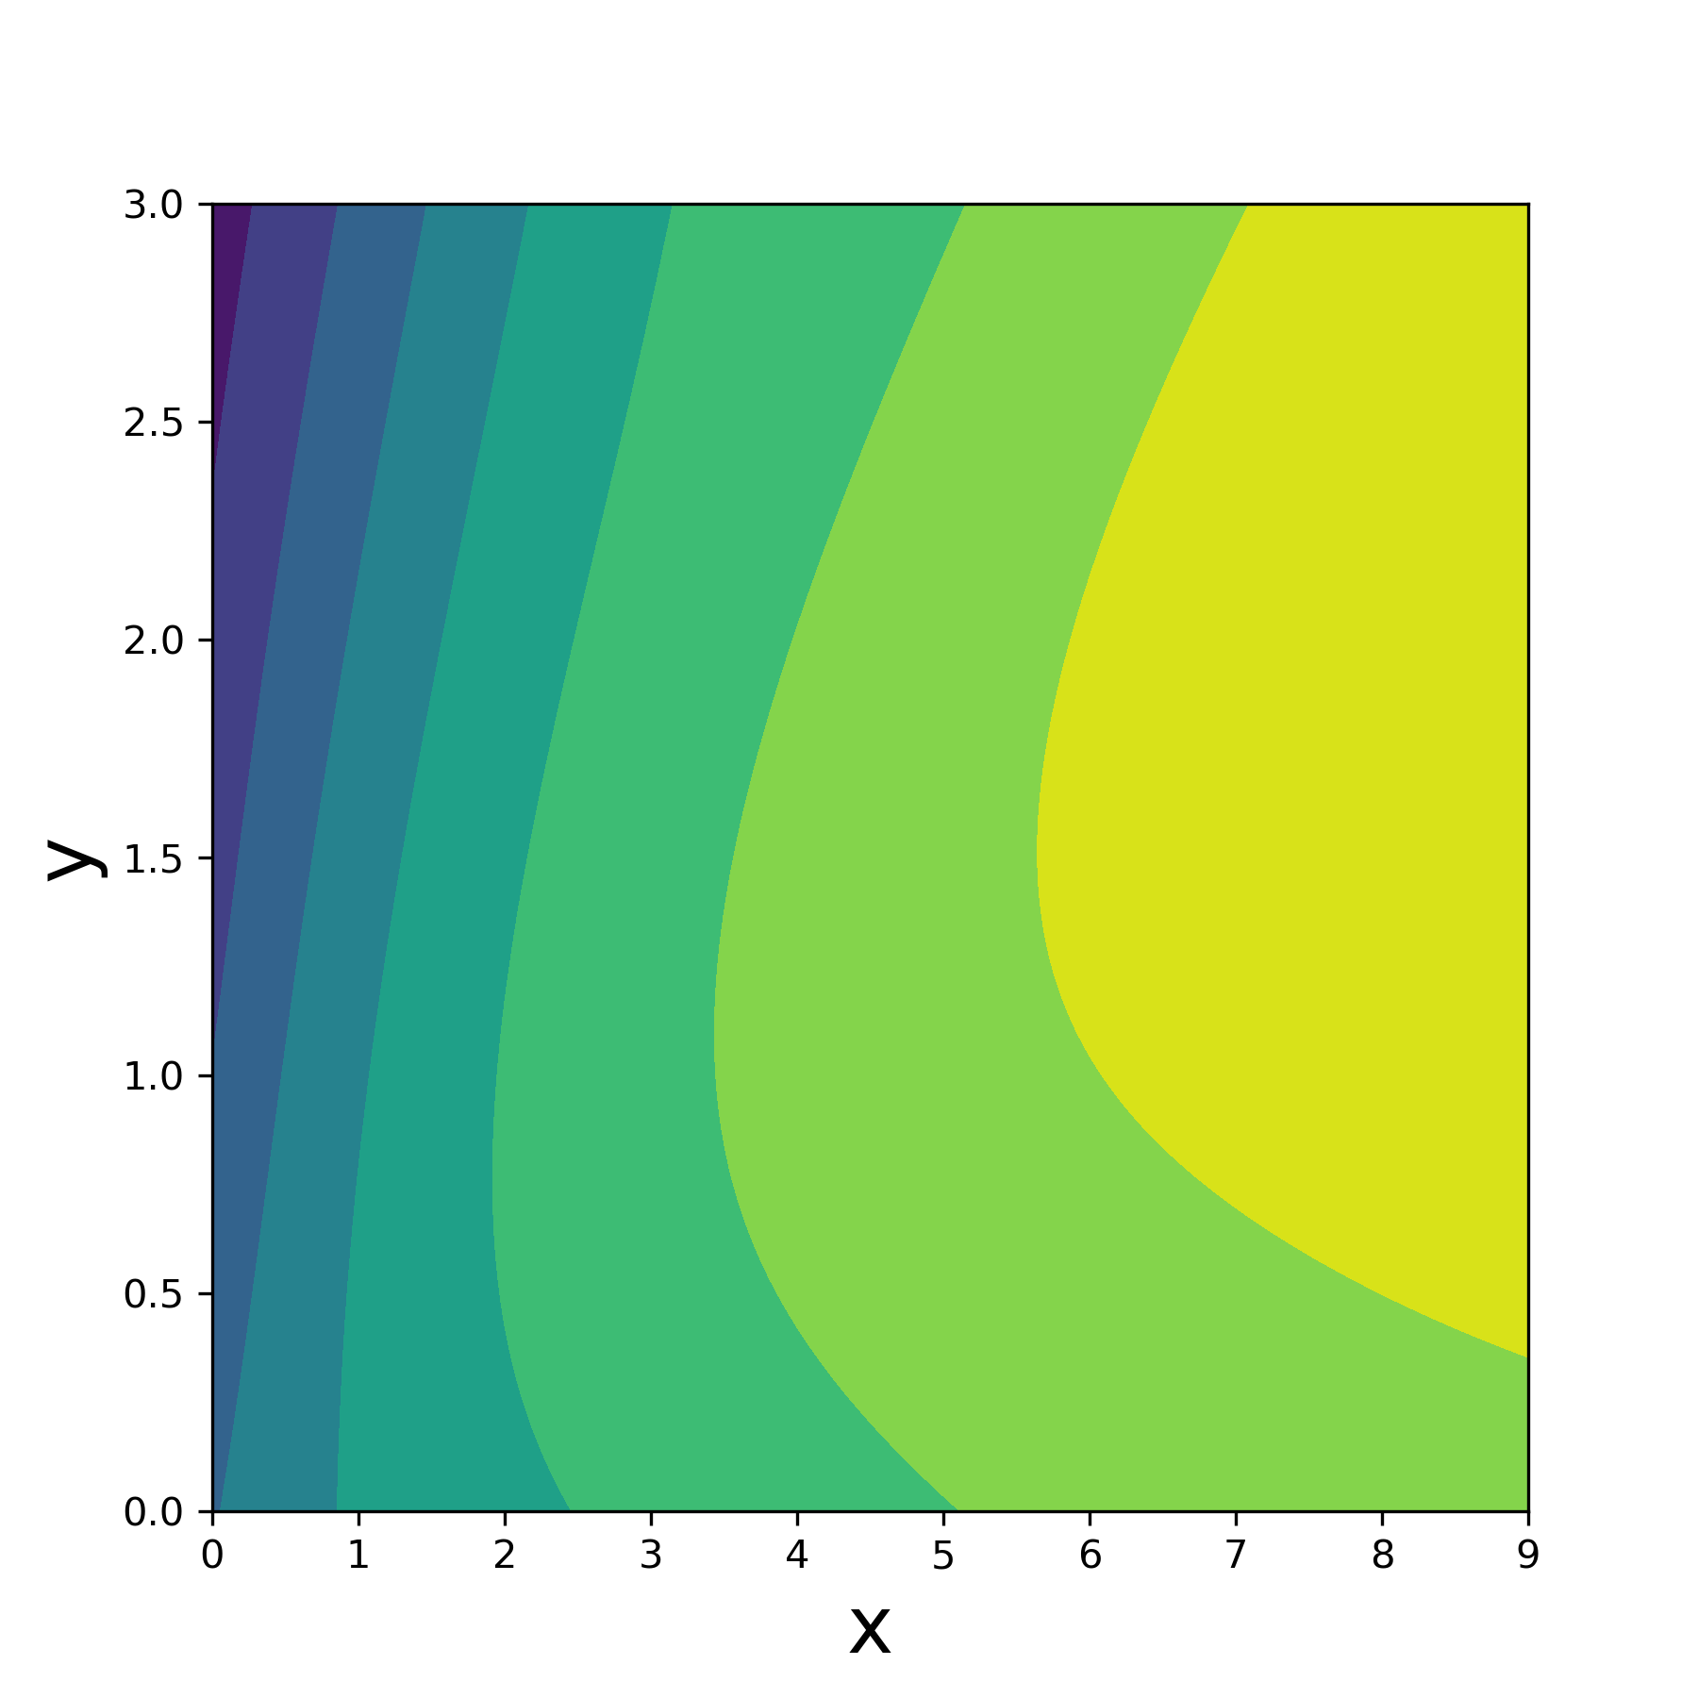
PINN example: 2D Laplace equation

Slide 7
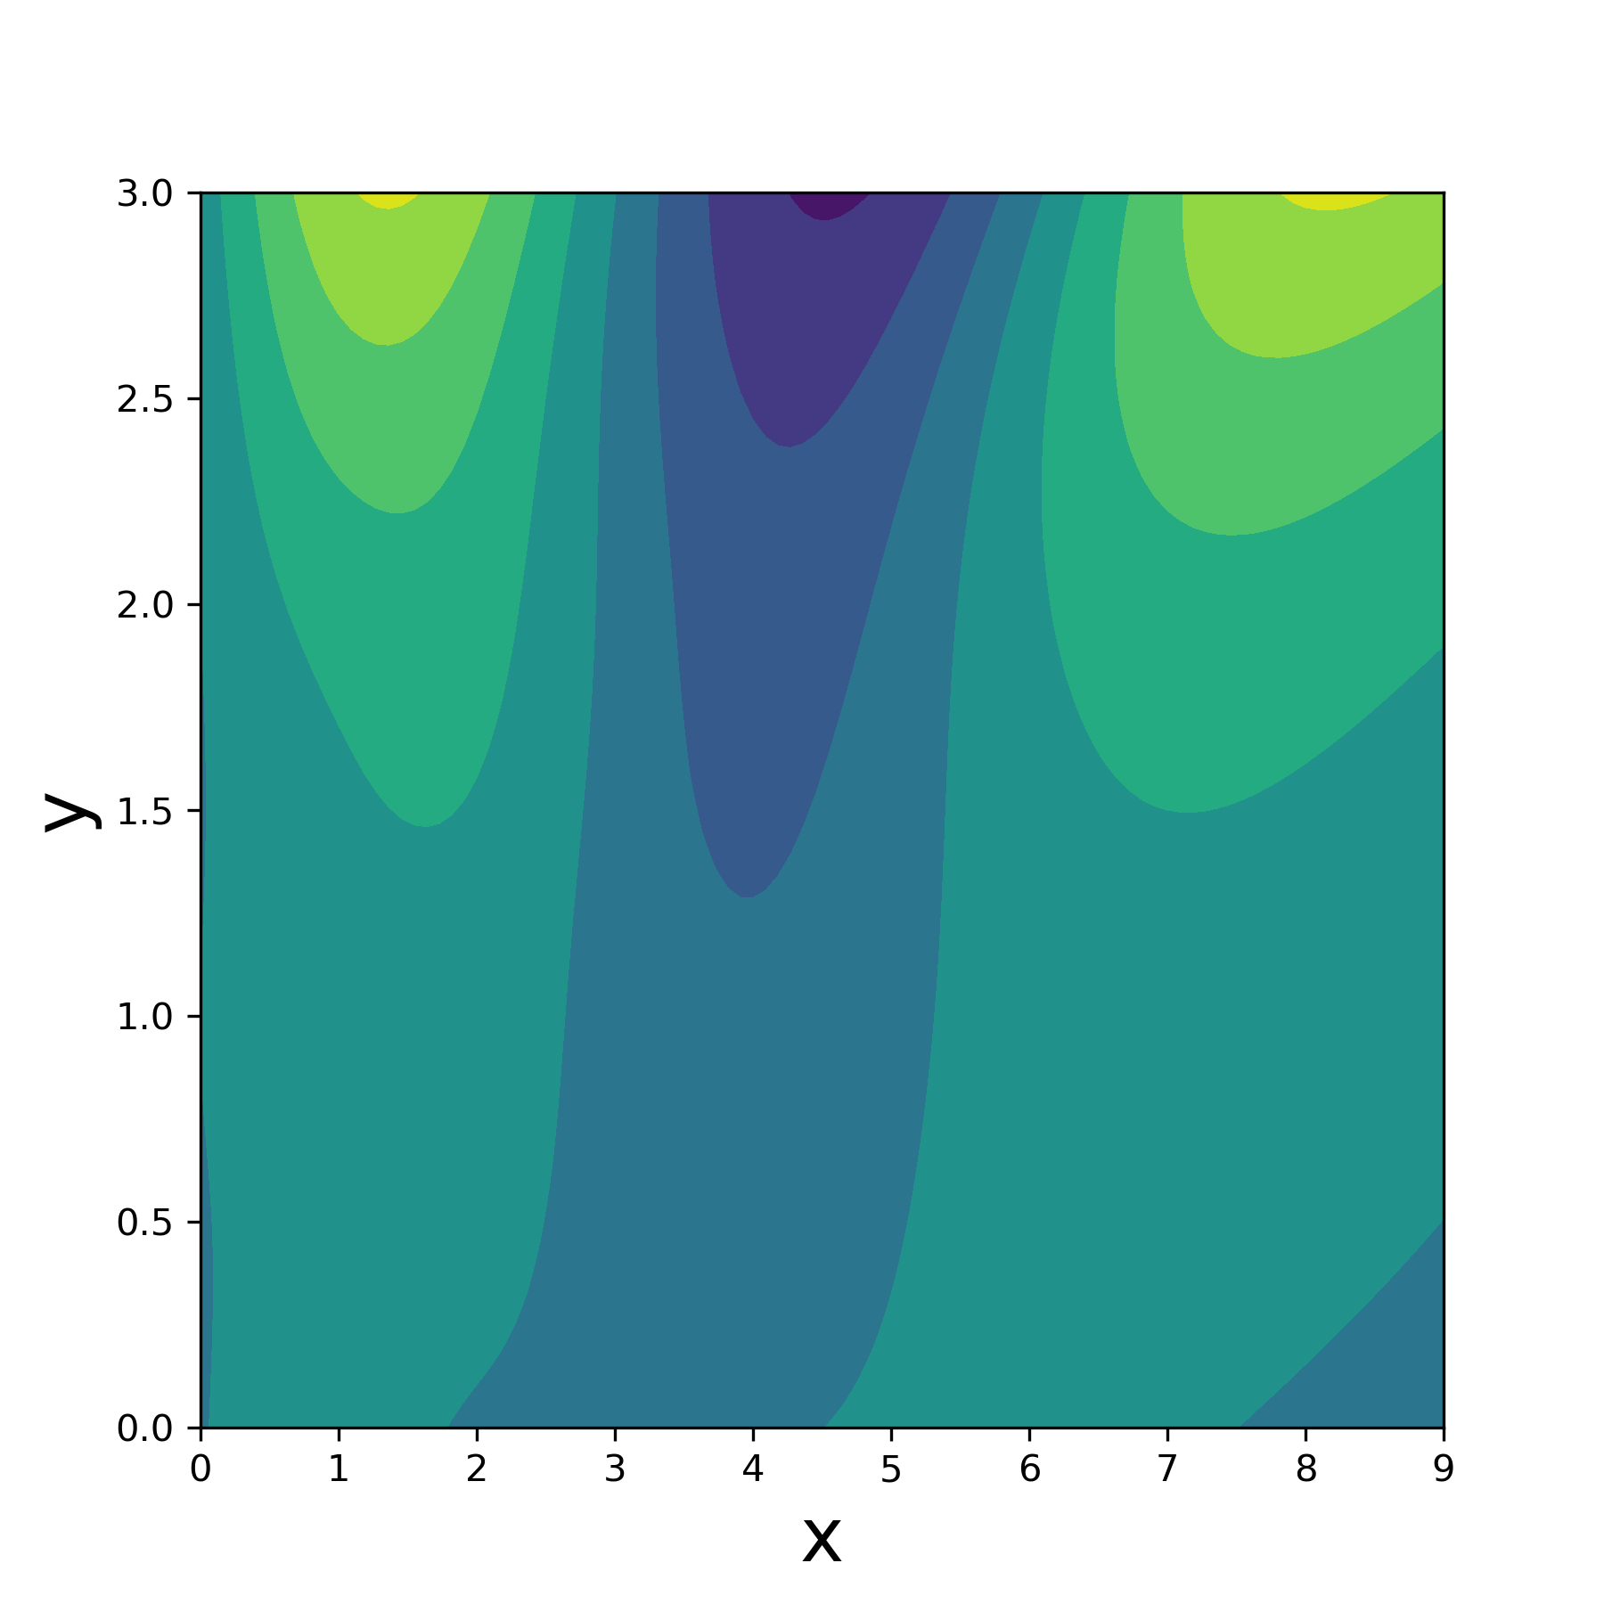
PINN example: 2D Laplace equation

Slide 8

PINN example: 2D Laplace equation

Slide 9
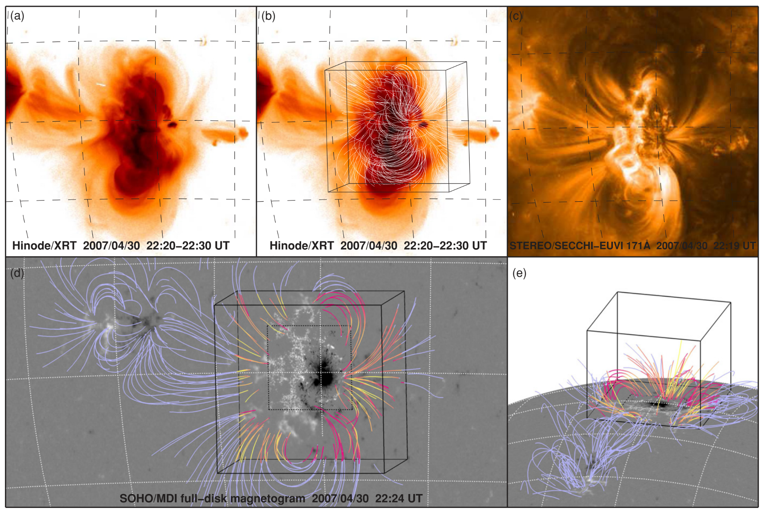
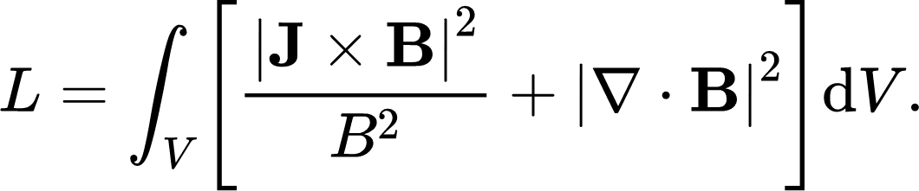

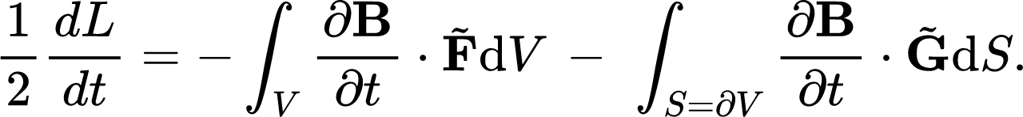
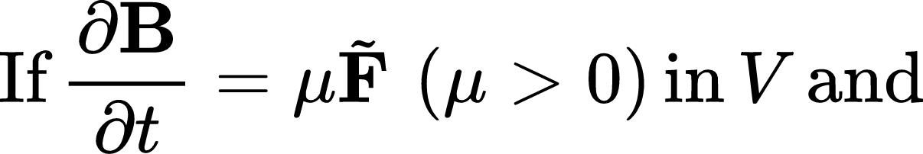
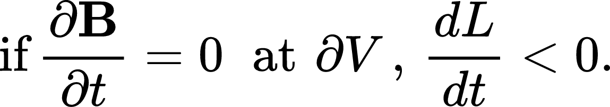
Optimization Method for Force-Free Fields
Wheatland et al. 2000
DeRosa et al. 2009
The route toward the solution is clear and transparent.

Slide 10
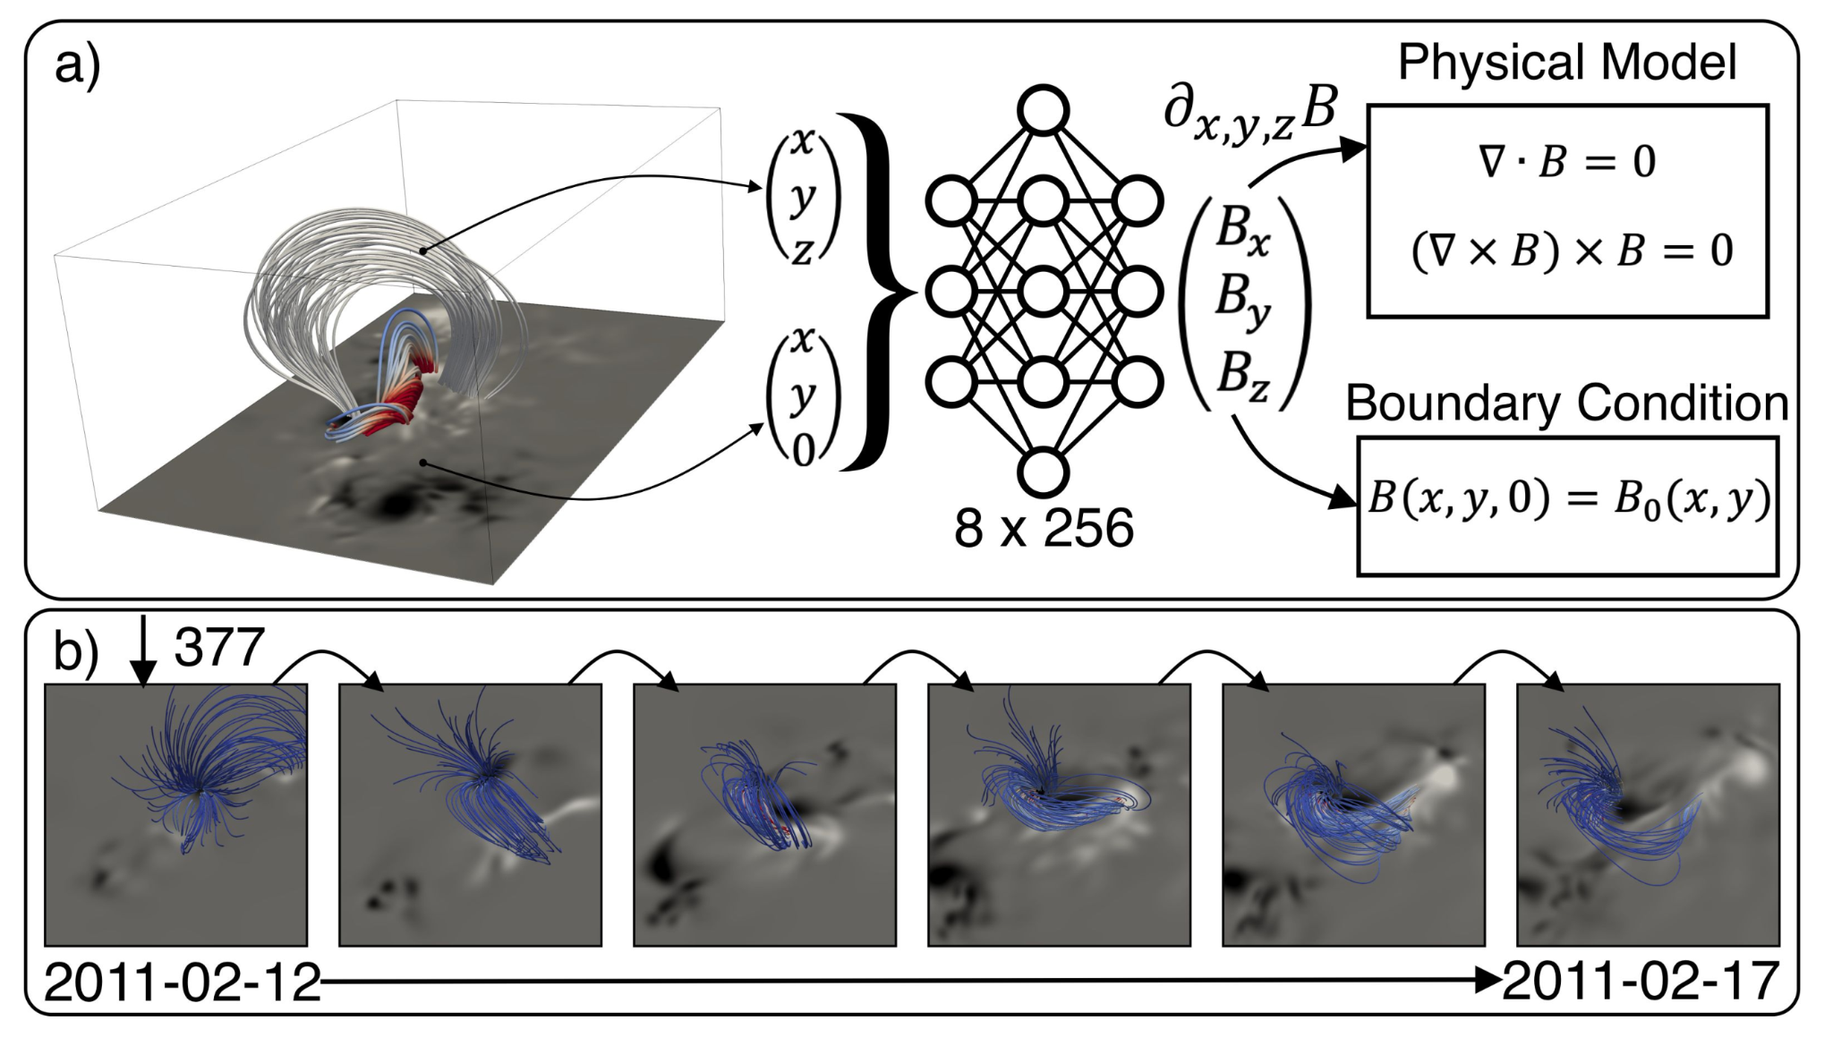
PINNs for Force-Free Fields
Jarolim et al. 2022

Slide 11
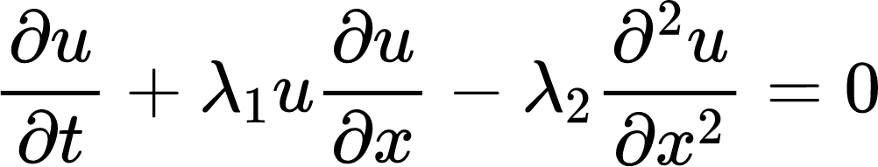
Forward problem and Inverse problem

Slide 12
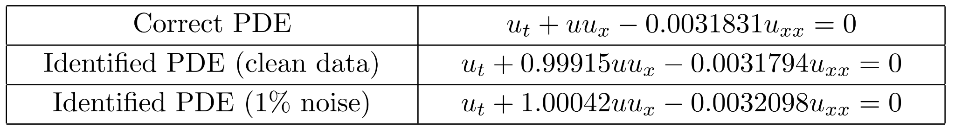
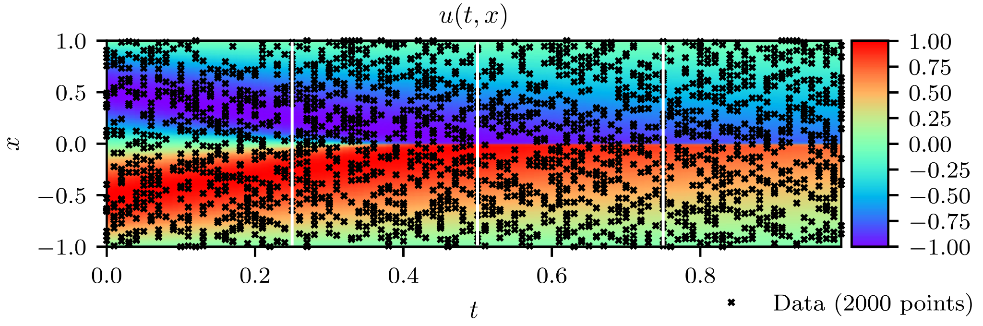
Inverse problem
Raissi et al. 2019

Slide 13
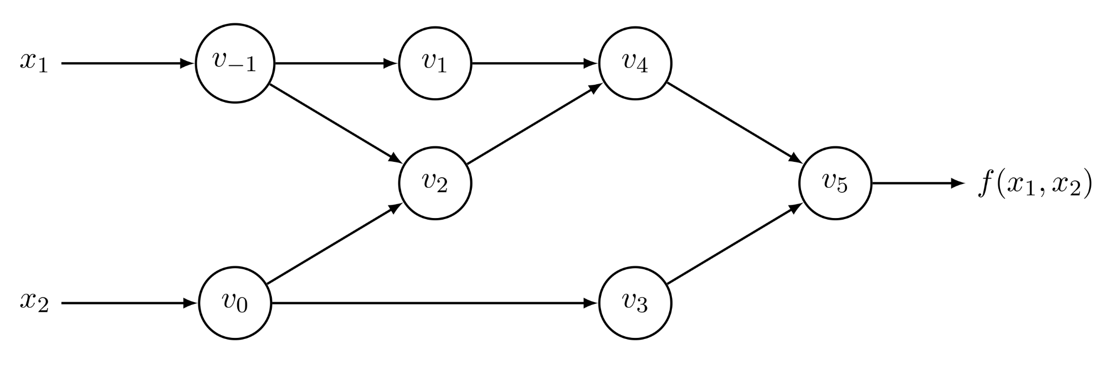
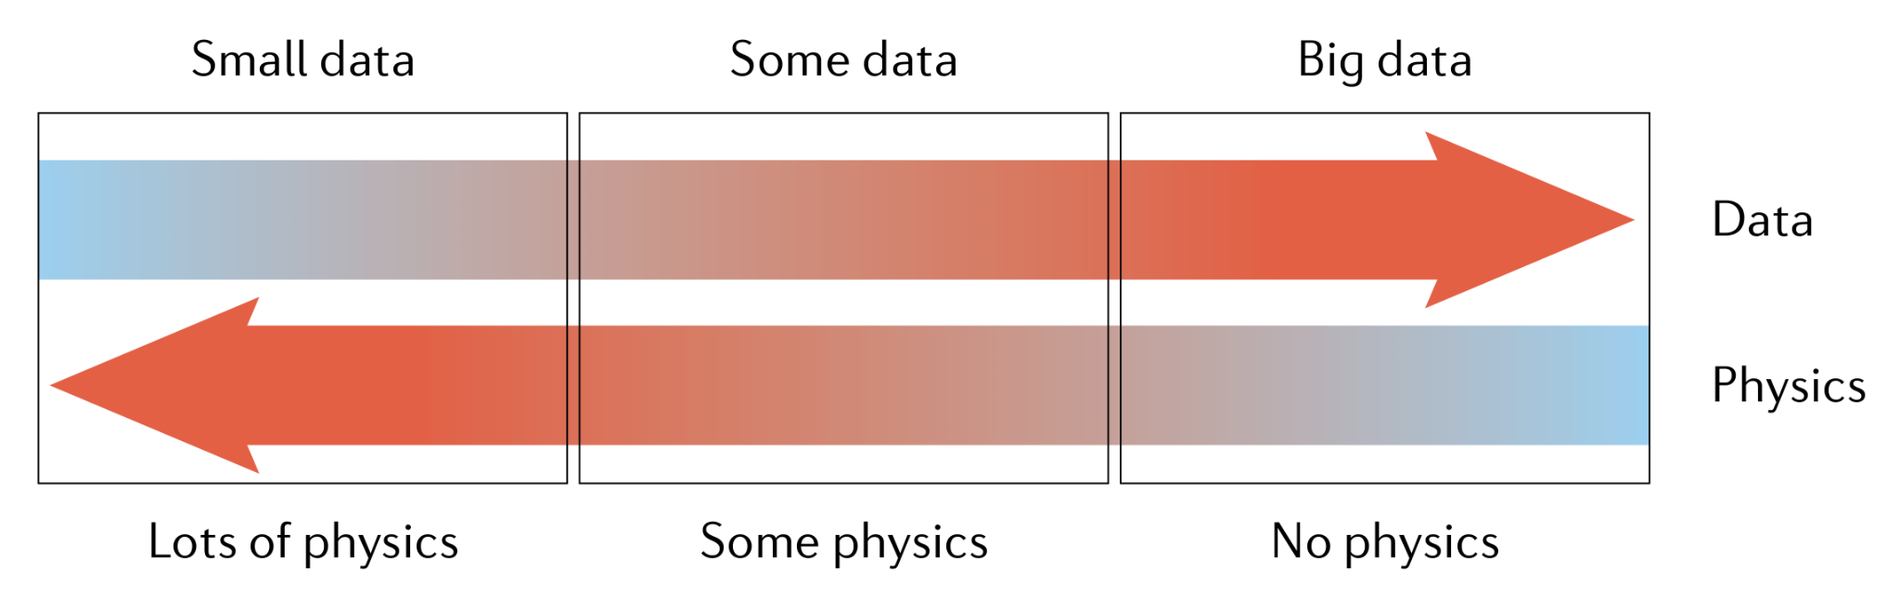
Two Elements of PINNs
Numerical methods with automatic differentiation
Baydin et al. 2018
Machine learning techniques with physical constraints
Karniadakis et al. 2021

Slide 14
Conclusion
Recently, physics-informed neural networks (PINNs) are proposed as another method to find numerical solutions of differential equations.
The overall strategy of PINNs is not quite different from that of traditional numerical methods in that both methods pursue paths leading to extrema in certain optimization problems.
The crux of PINNs is the automatic differentiation (algorithmic differentiation), which does not require local differencing of variables, but involves their values at all collocation points.
PINNs do not "learn" from any provided solutions. The role of the provided data for training in conventional machine learning is taken by boundary and/or initial conditions in PINNs.

Slide 15
Thank You
For Your Attention

Slide 16
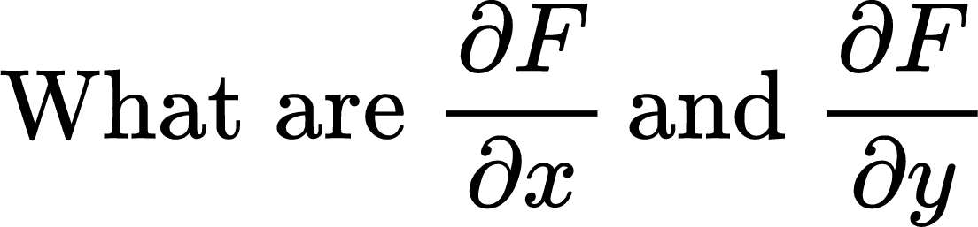
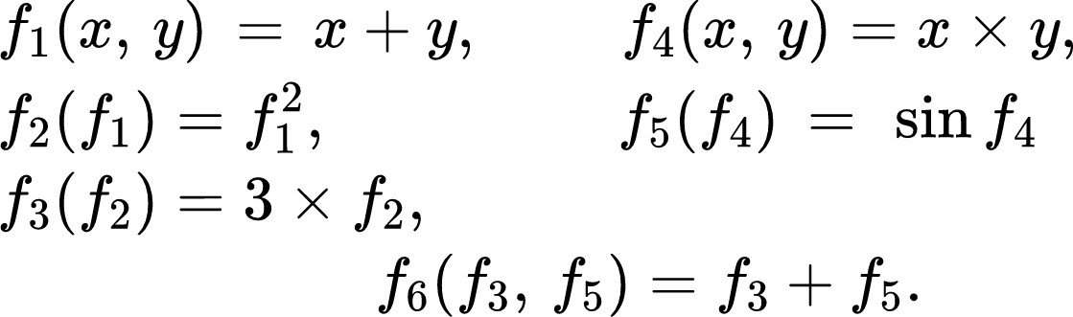
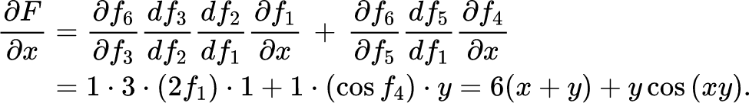
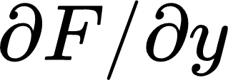


Automatic differentiation (Algorithmic diff.)
We can evaluate
in a similar way.
Here
and
are not symbols, but specific numbers.
We just make the computer know the derivative functions of the intrinsic operations (+, −, *, /, **) and functions (sin, cos, exp, etc.) built into it.

Slide 17
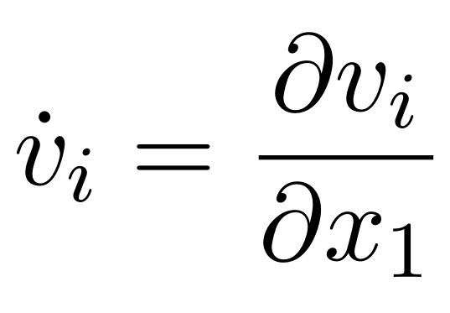
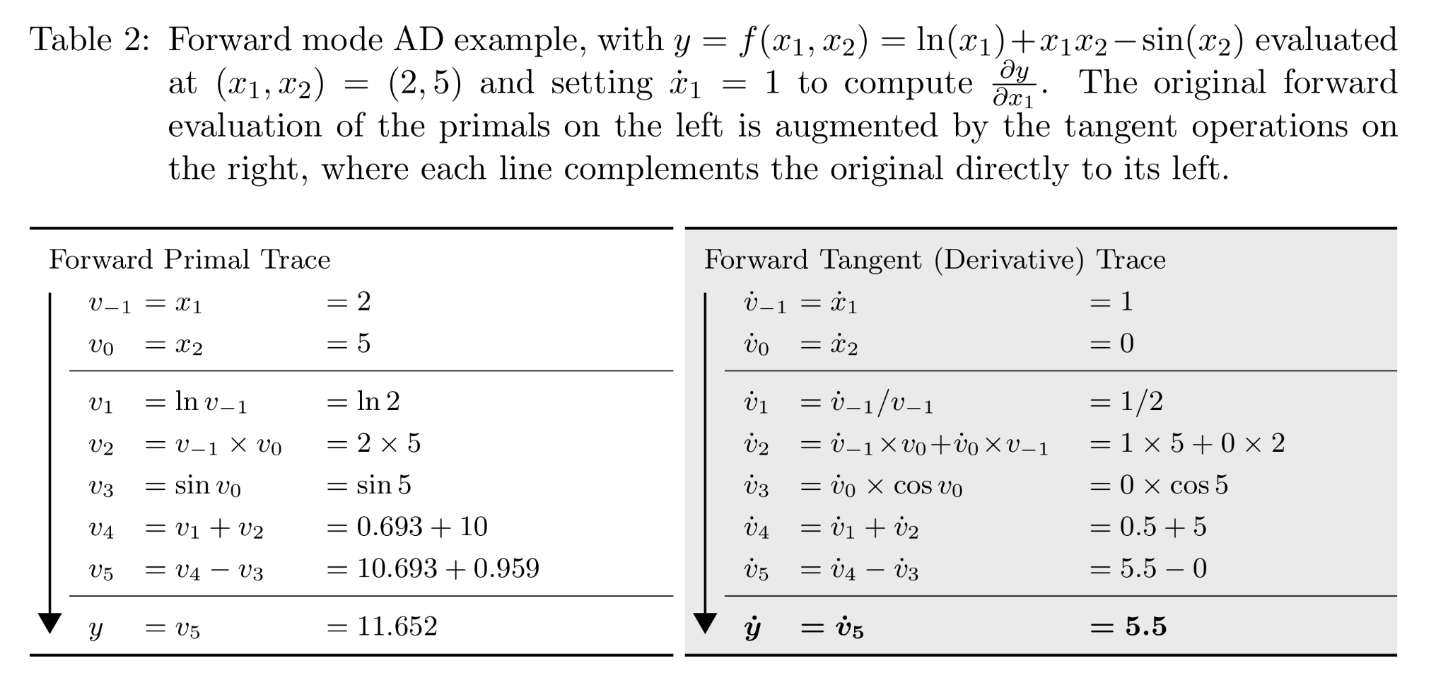
Automatic differentiation - Forward mode
Baydin et al. 2018

Slide 18
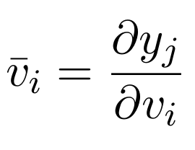
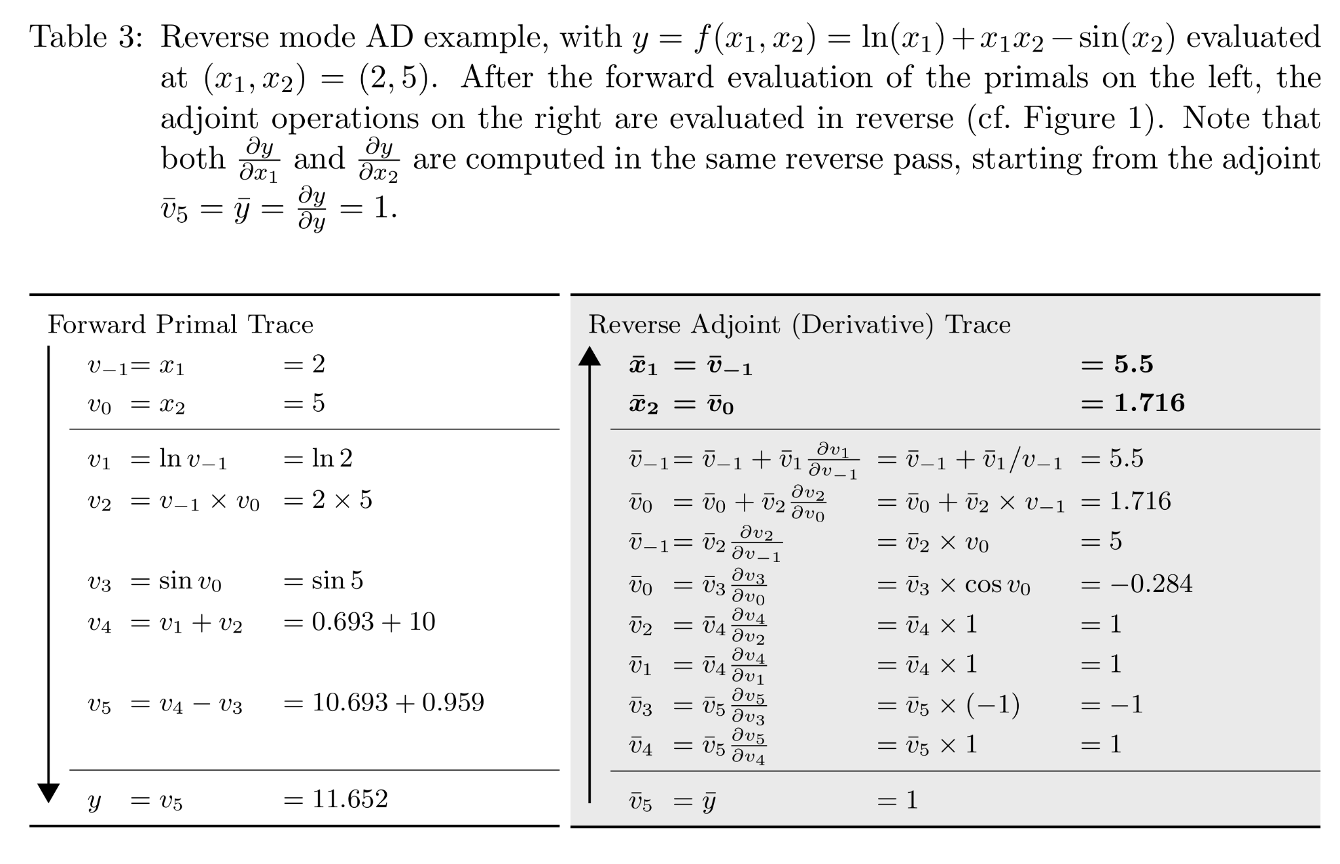
Automatic differentiation - Reverse mode
Baydin et al. 2018

Slide 19
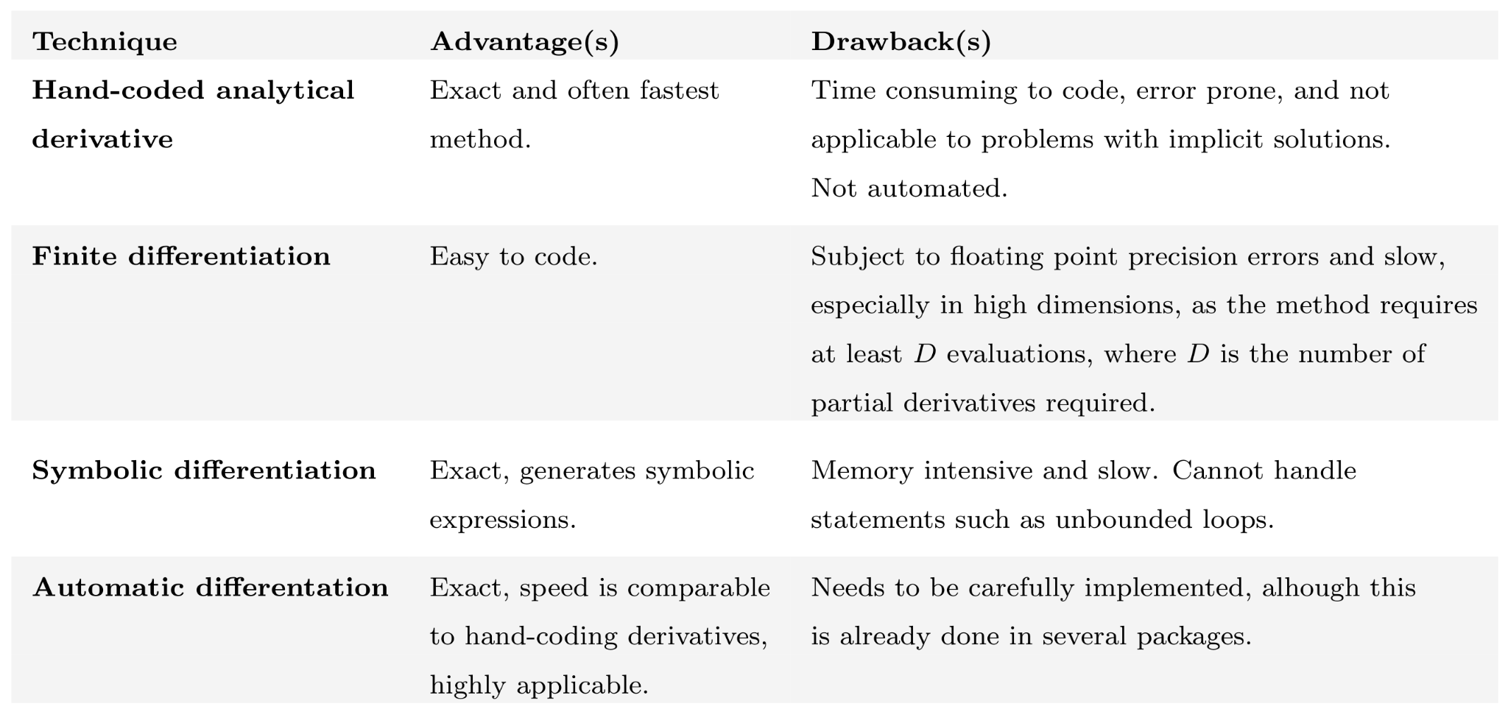
Techniques to calculate derivatives
= Manual differentiation
= Numerical differentiation
Margossian 2019

Slide 20
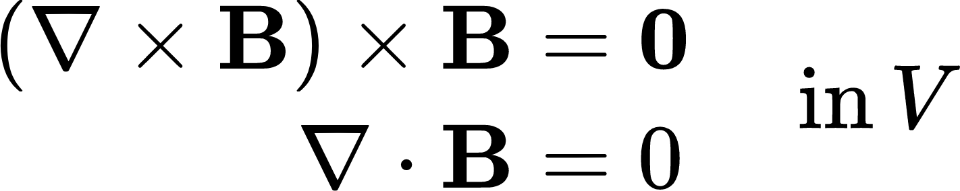
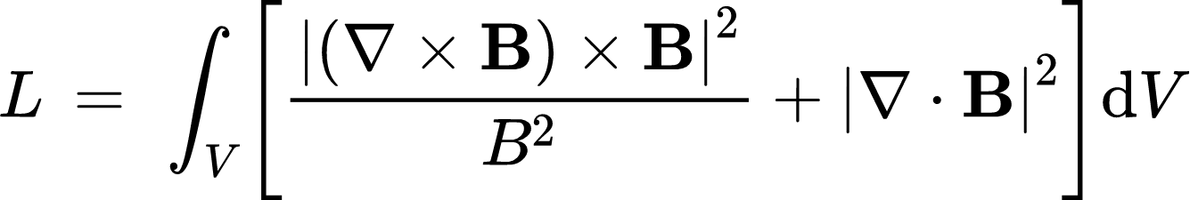
Optimization Method for Force-Free Fields
DeRosa et al. 2009
Wheatland et al. 2000

Slide 21
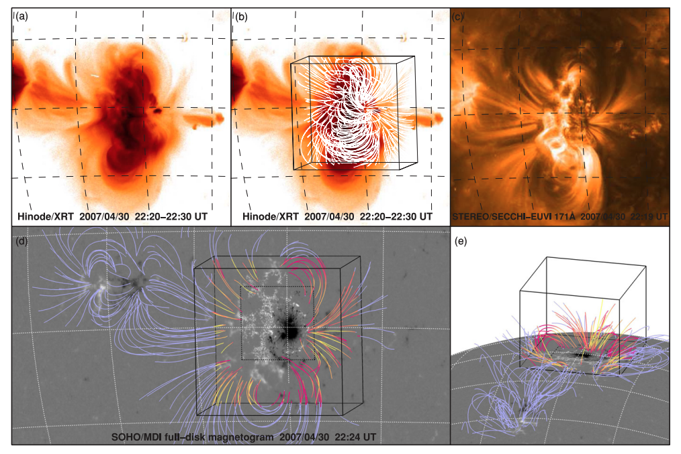
Nonlinear force-free fields (NLFFFs)
DeRosa et al. 2009

Slide 22
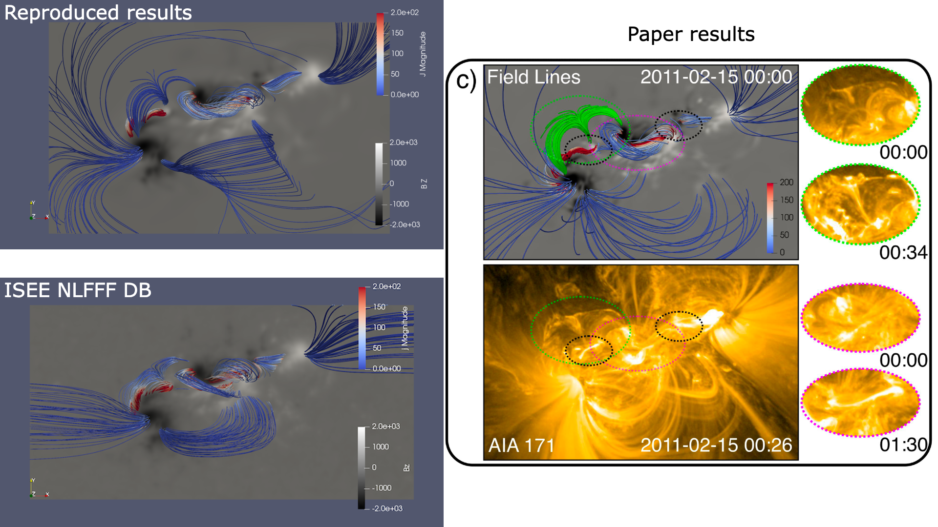
PINNs for Force-Free Fields

Slide 23
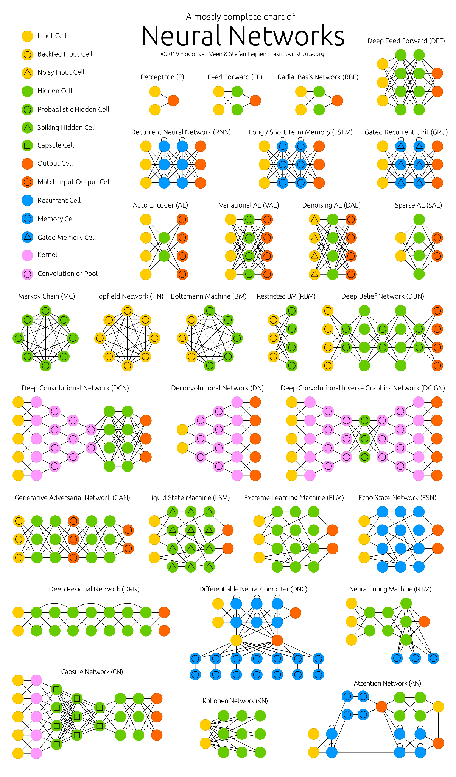
Neural Networks
https://www.asimovinstitute.org/neural-network-zoo/

Slide 24
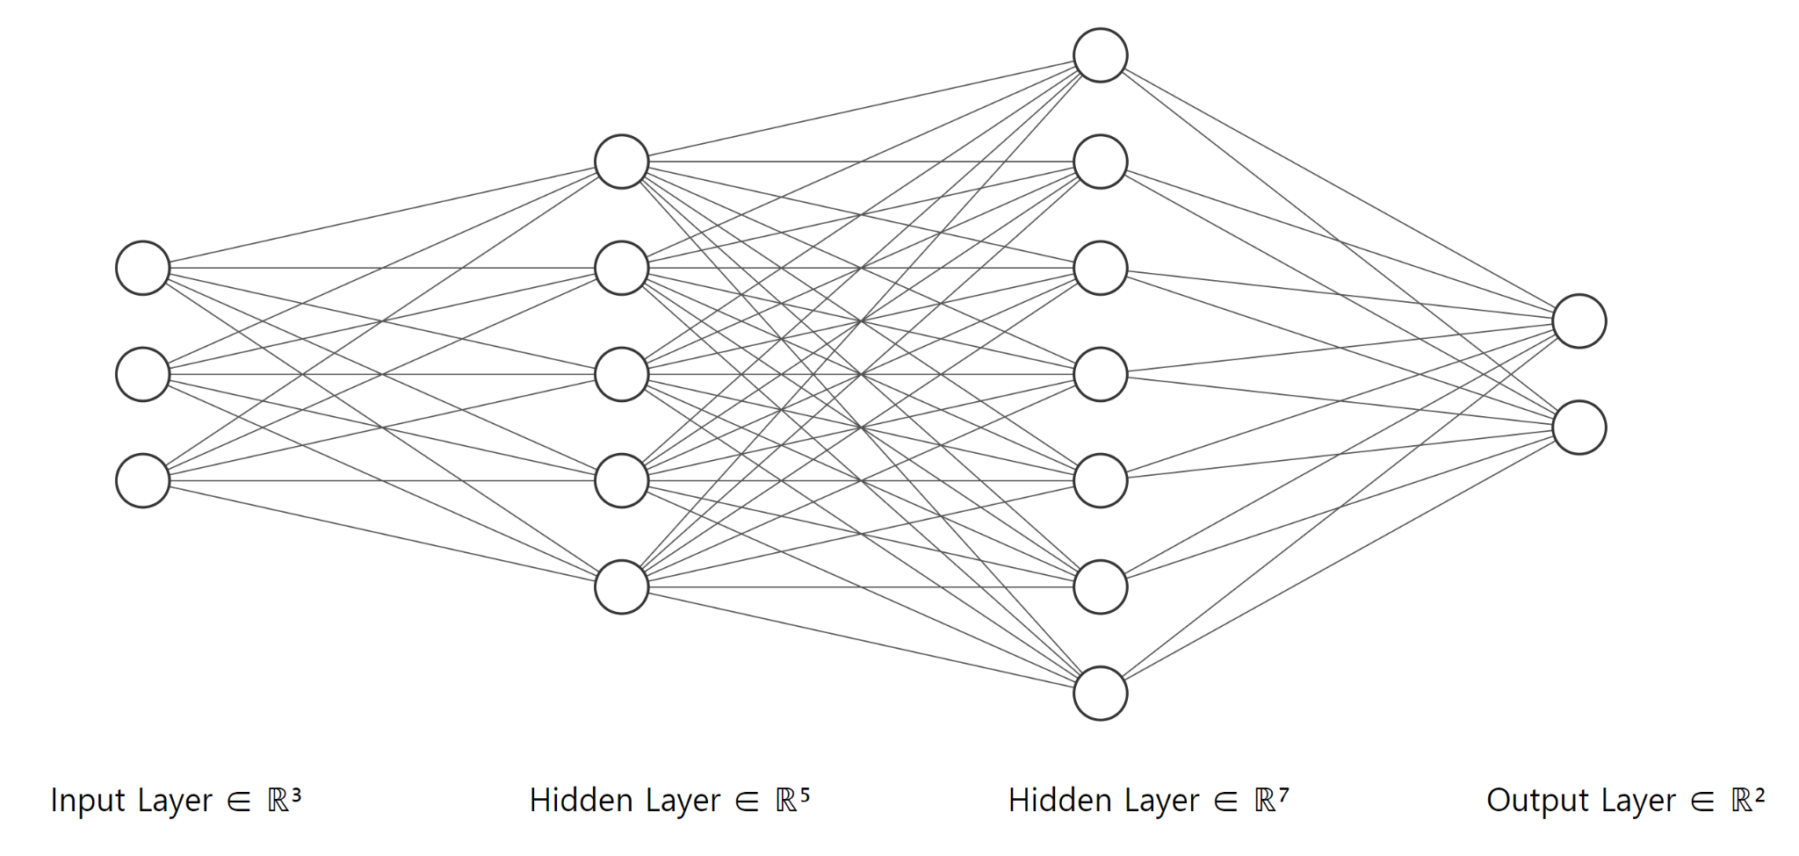
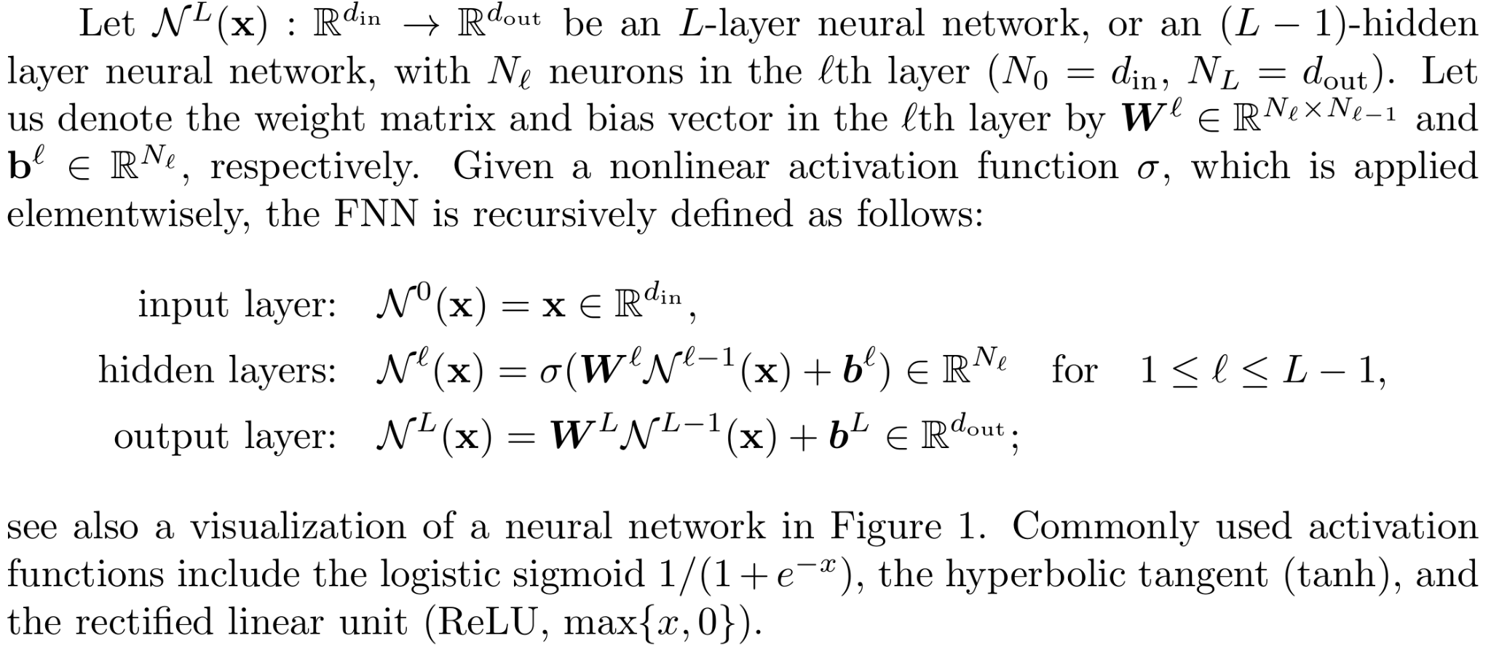
Feedforward neural network (FNN)
= Multilayer perceptron (MLP)
Lu et al. 2021

Slide 25
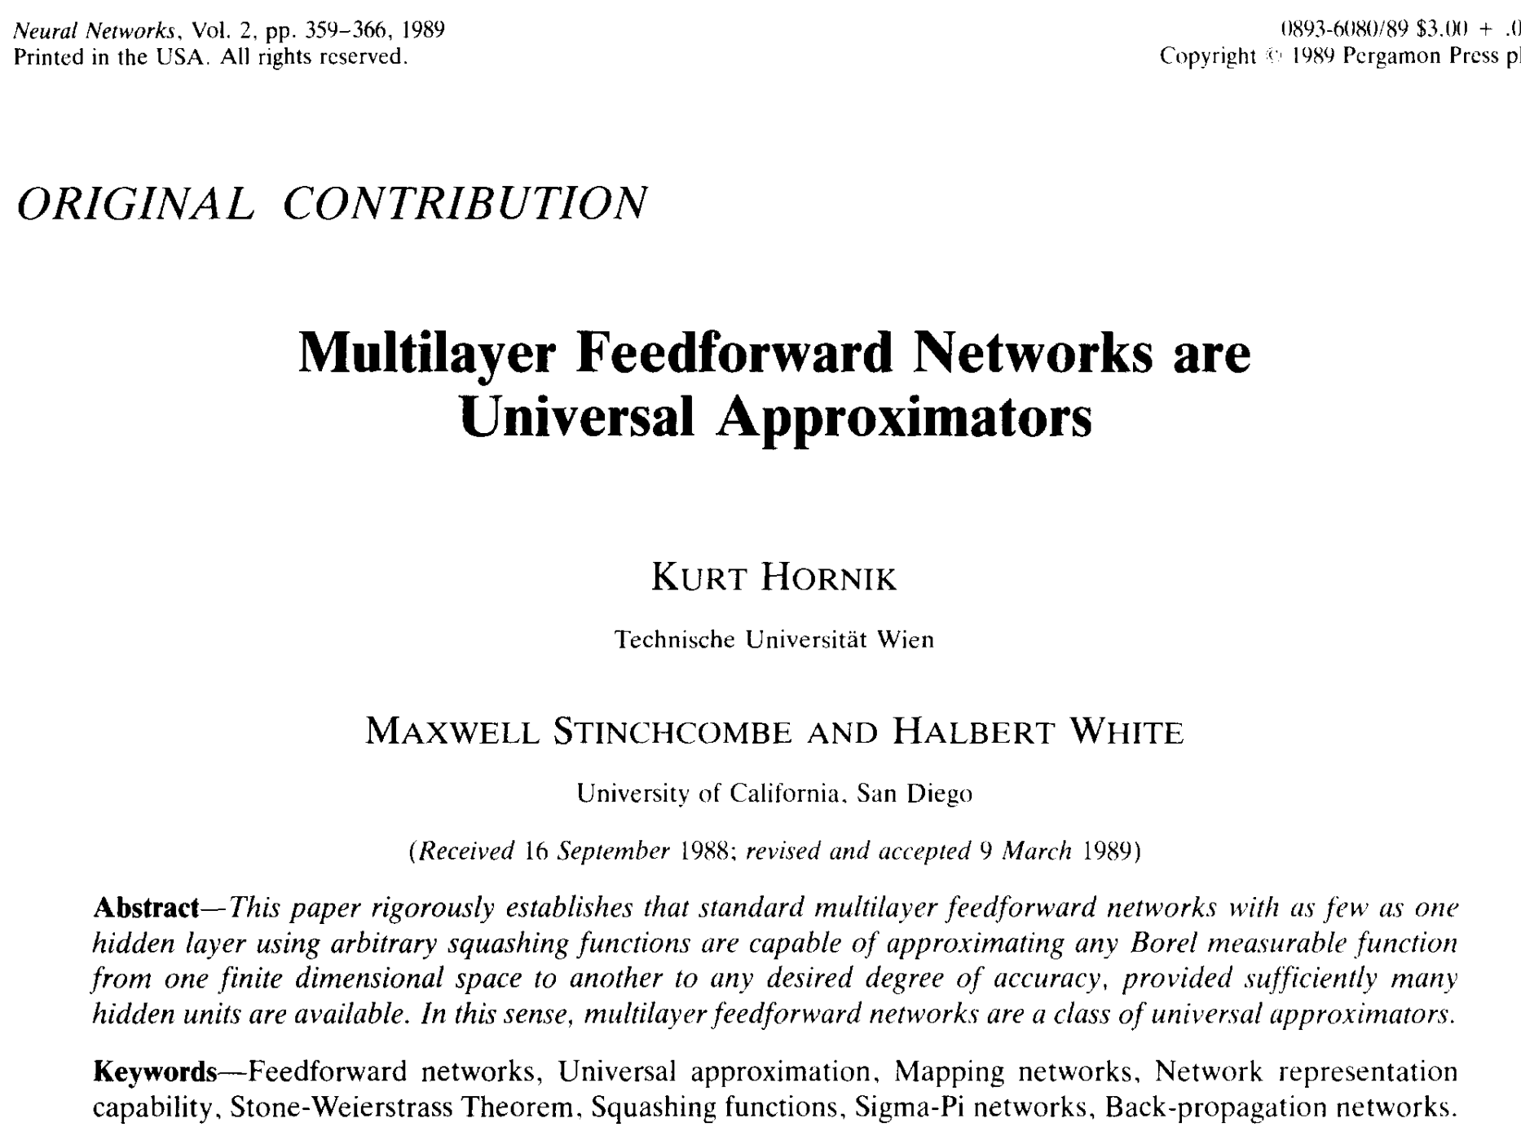
Universal approximation theorem
Hornik et al. 1989

Slide 26

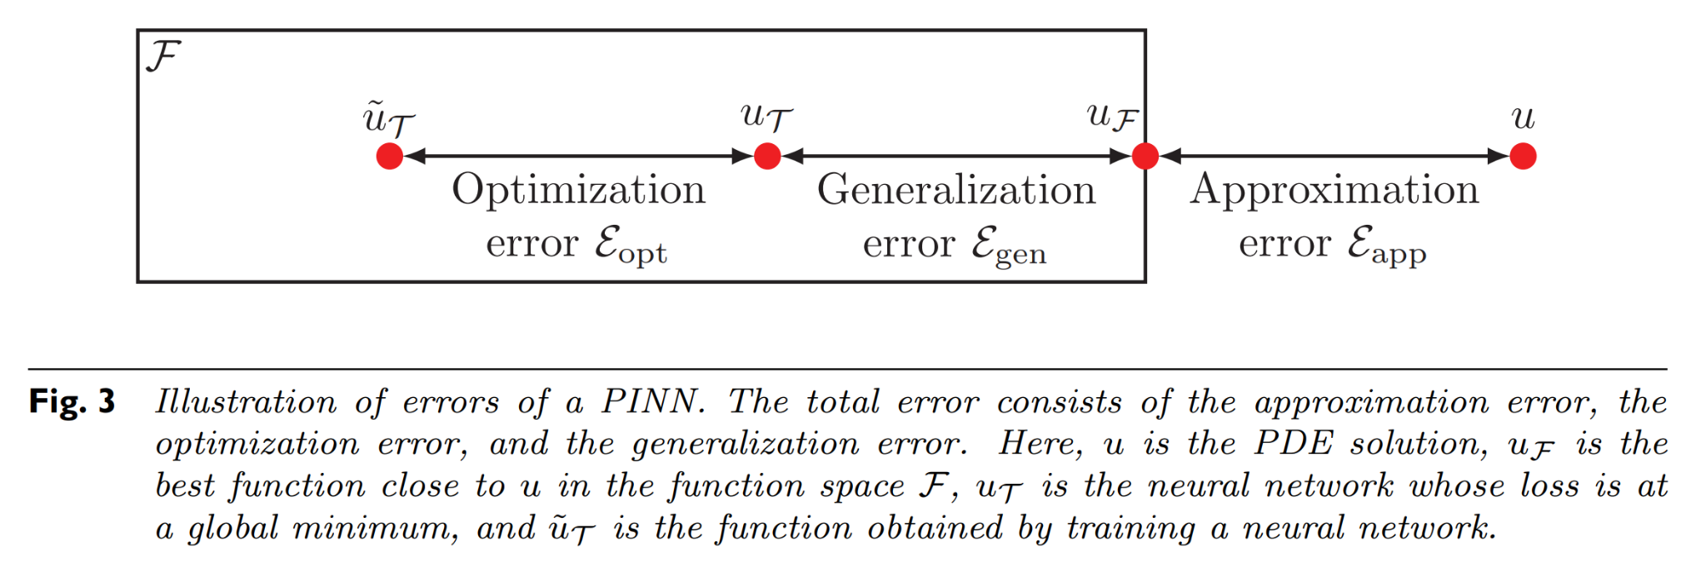
Universal approximation theorem
Feed-forward neural nets (FNNs) with enough neurons can simultaneously and uniformly approximate any function and its partial derivatives.
: The family of all the functions that can be represented by our chosen neural network architecture.
Total Error
Lu et al. 2021

Slide 27
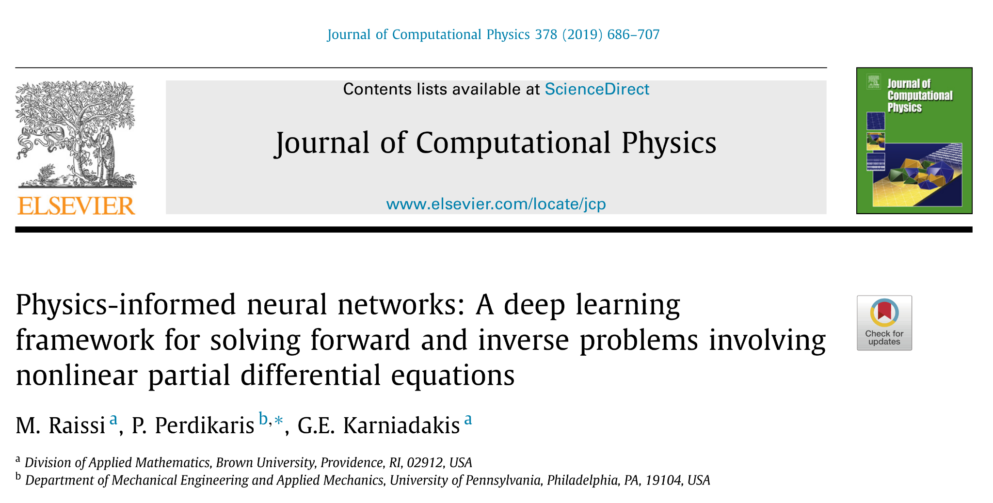
Physics-informed neural networks (PINNs)
Raissi et al. 2019

Slide 28
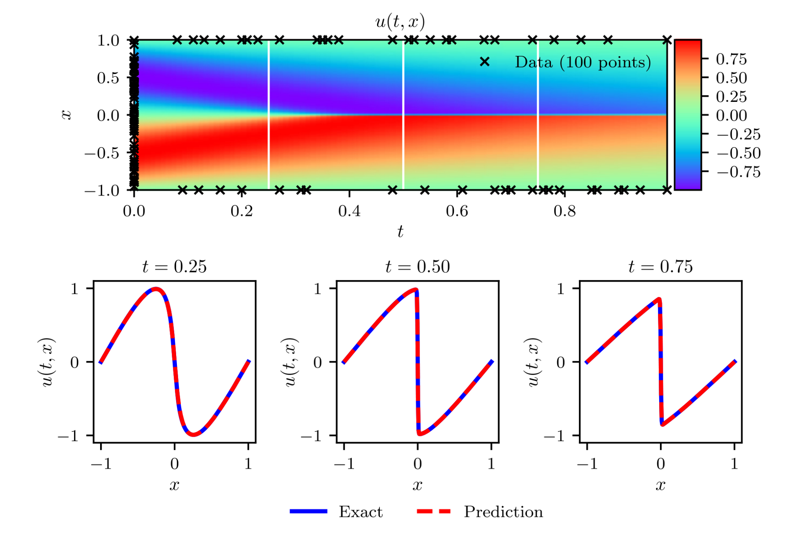
Forward problem
Raissi et al. 2019

